Slide 1
Django Geeky Show
by Dpu Barman

Slide 2
39. What is Cookie and How it works

Slide 3
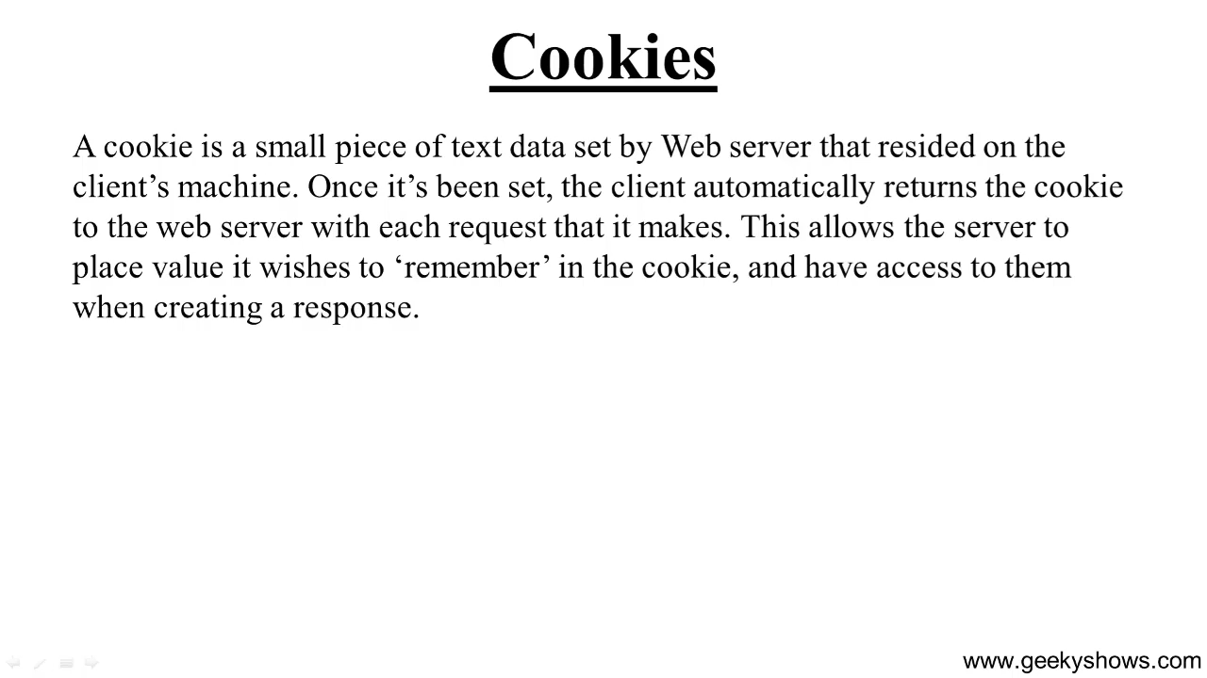

Slide 4
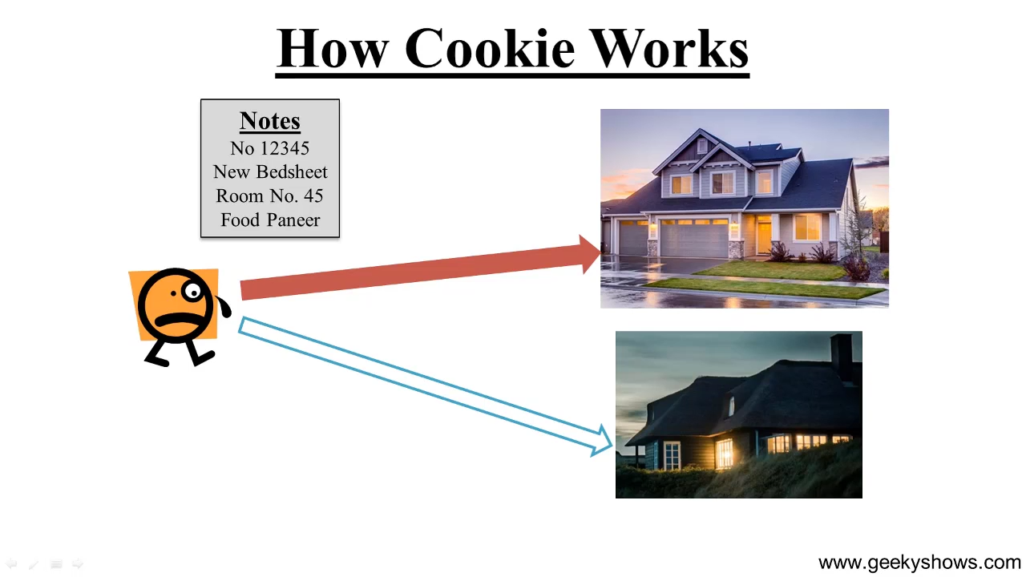

Slide 5
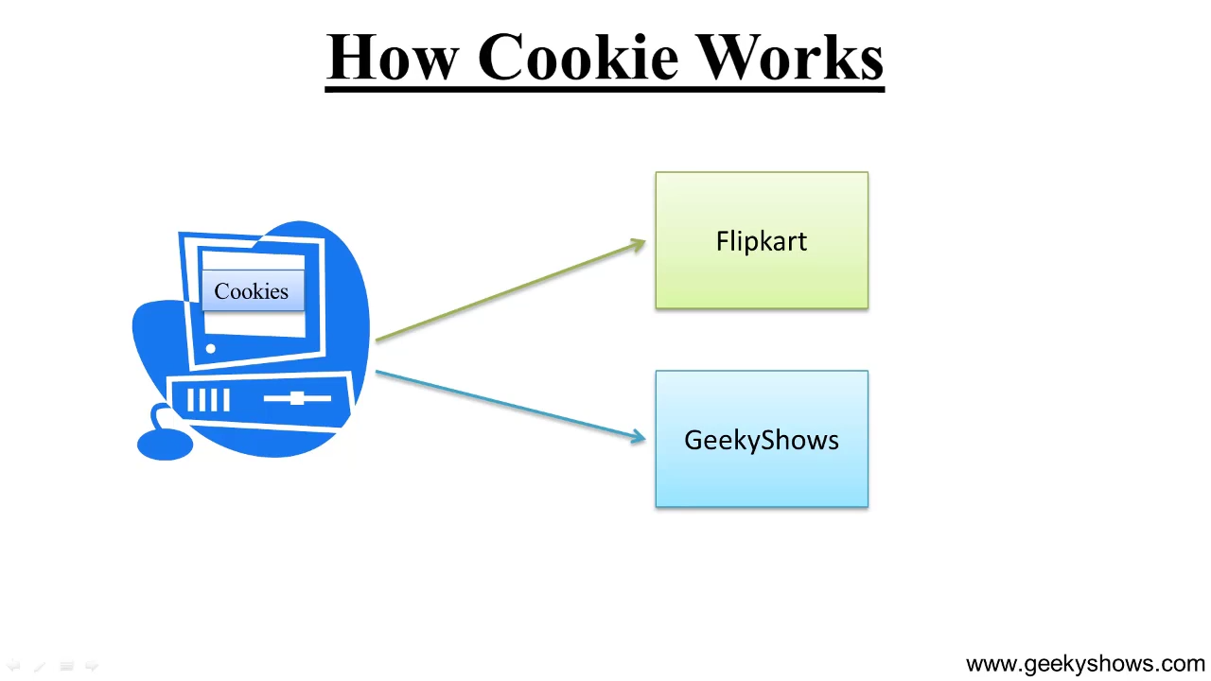

Slide 6
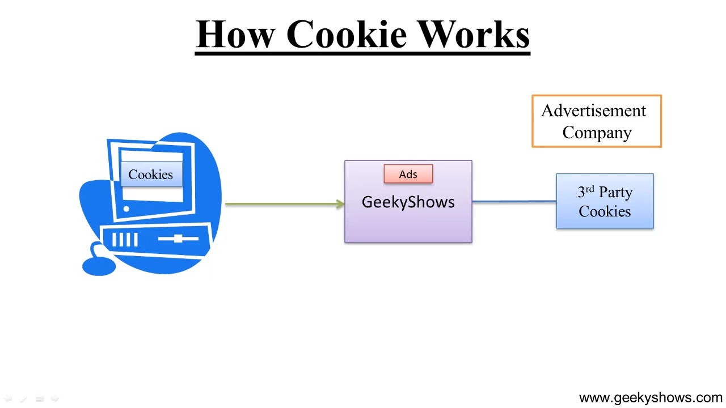

Slide 7
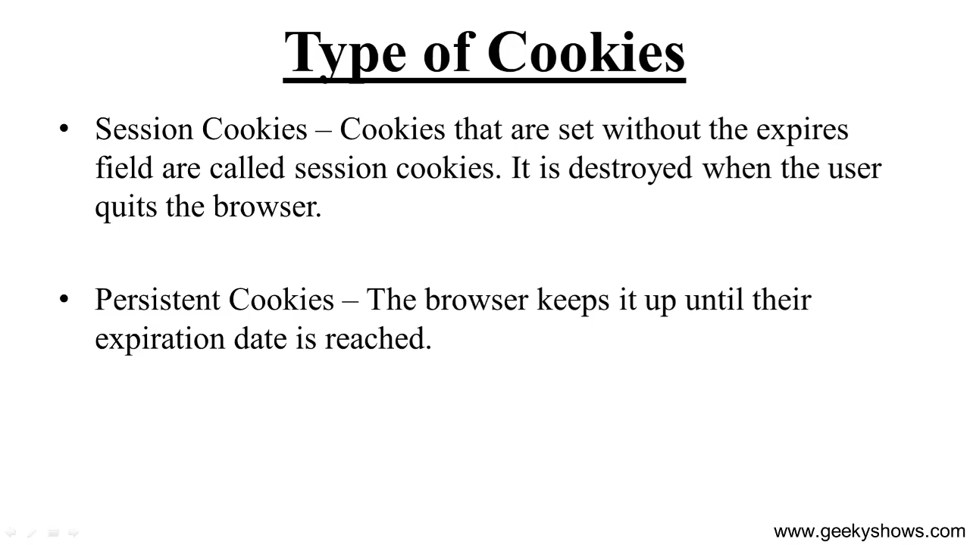

Slide 8
40. Object Relational Mapper and QuerySet in Django

Slide 9
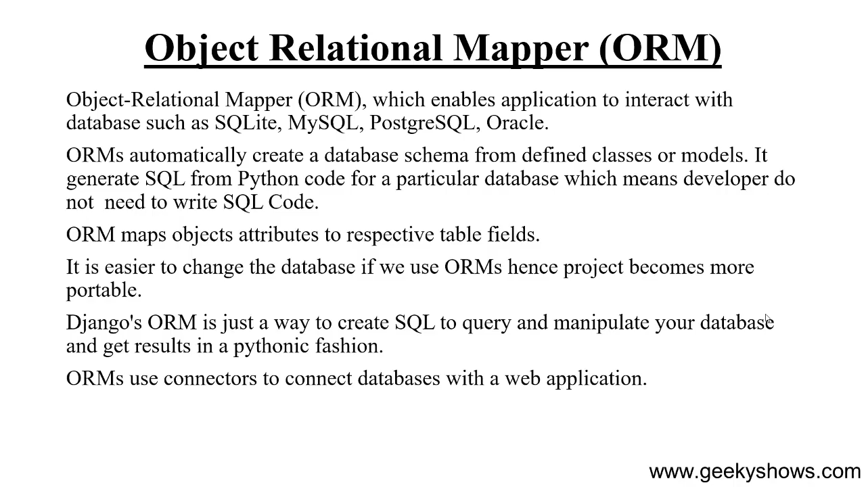

Slide 10
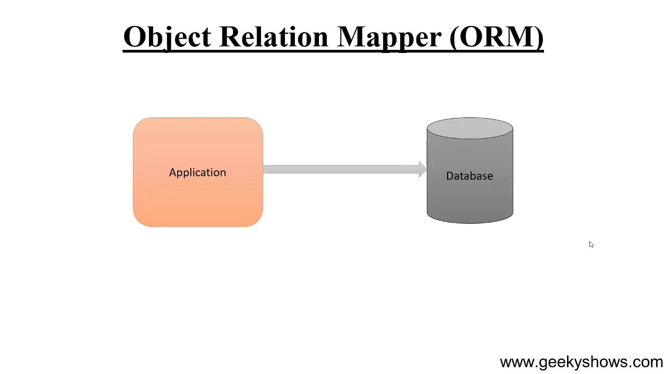

Slide 11
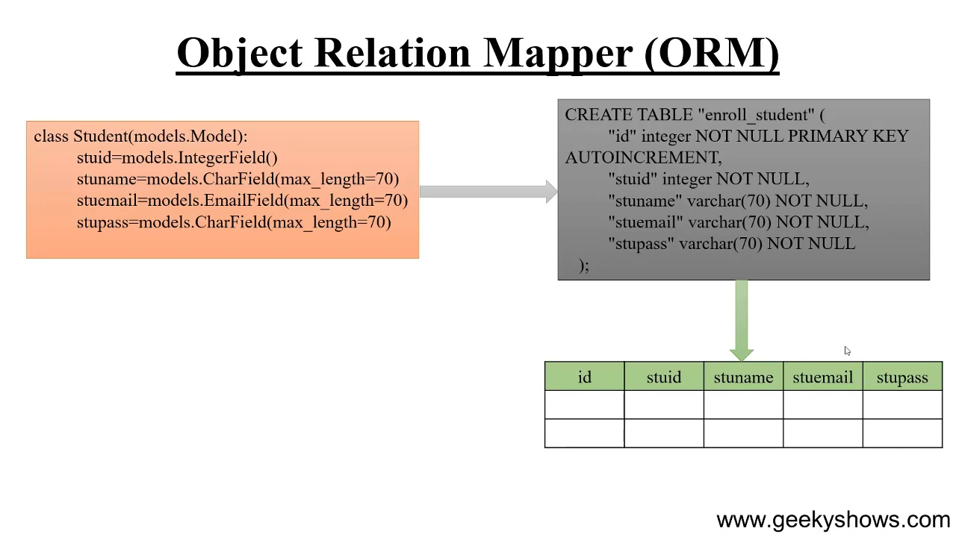

Slide 12
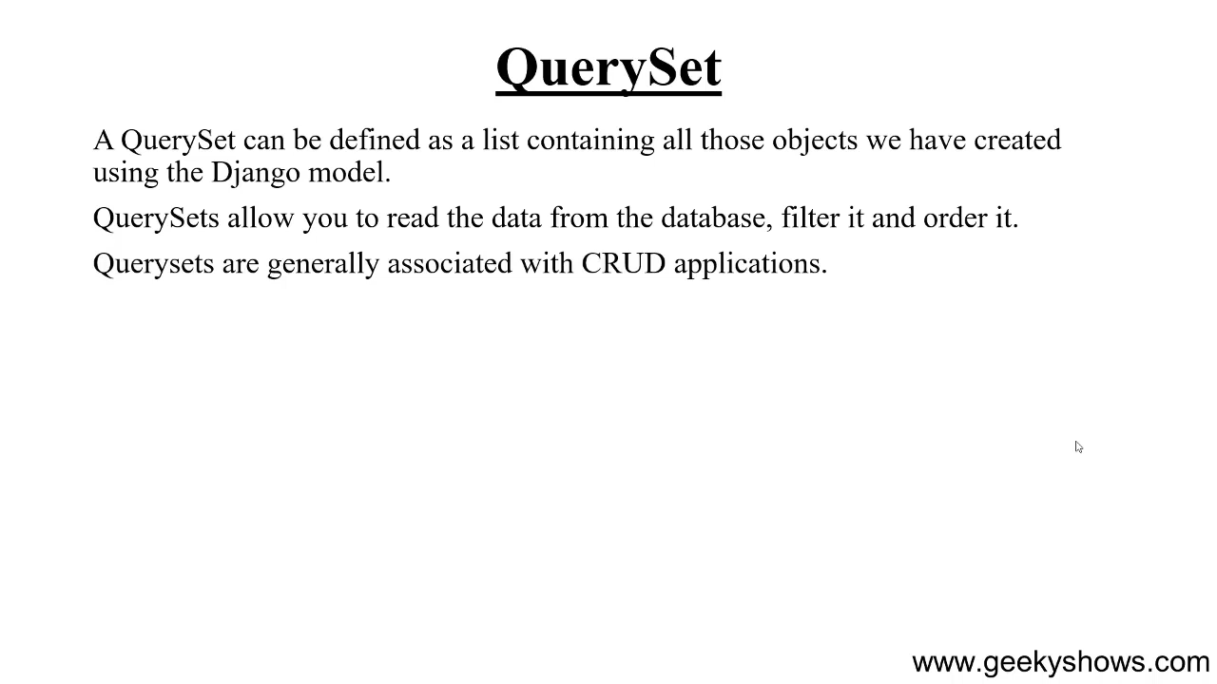

Slide 13
41. Model and How to Create Database Table in Django

Slide 14
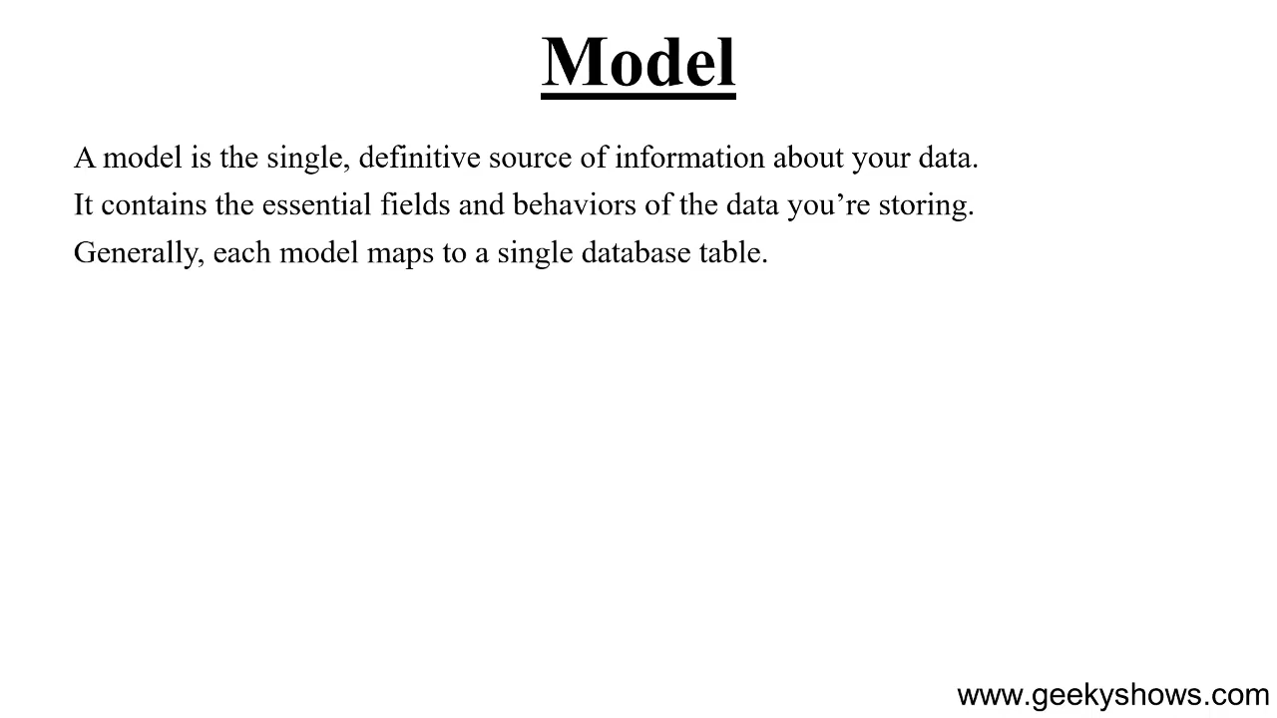

Slide 15
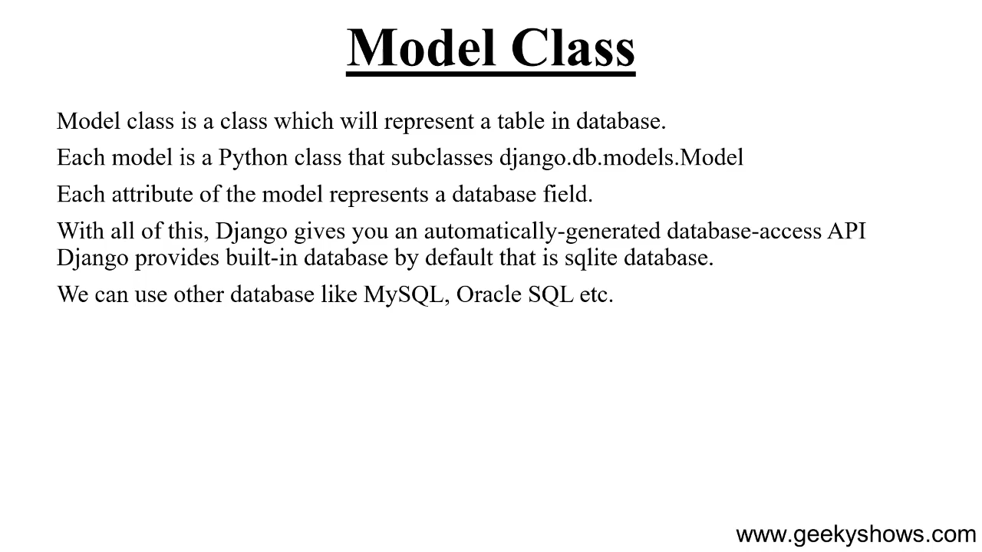

Slide 16
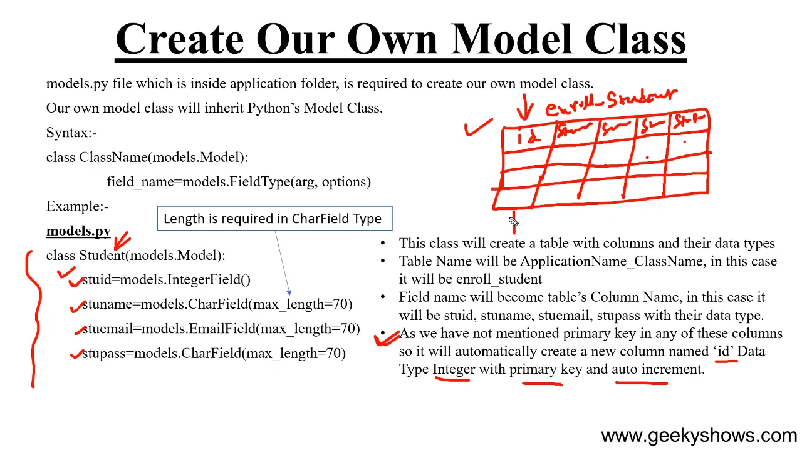

Slide 17
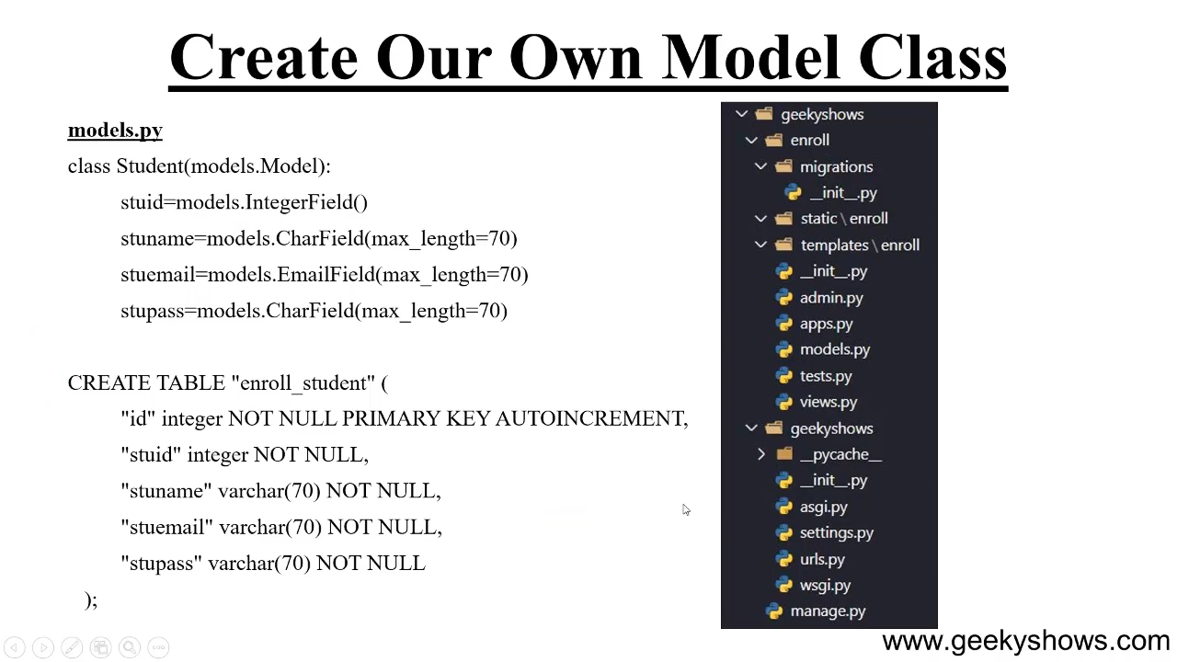

Slide 18
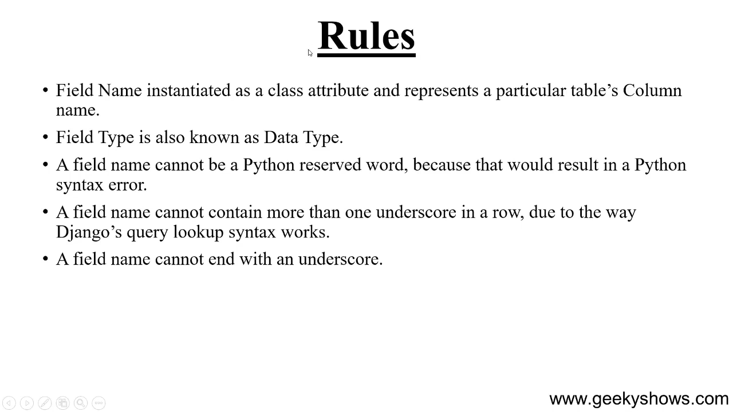

Slide 19
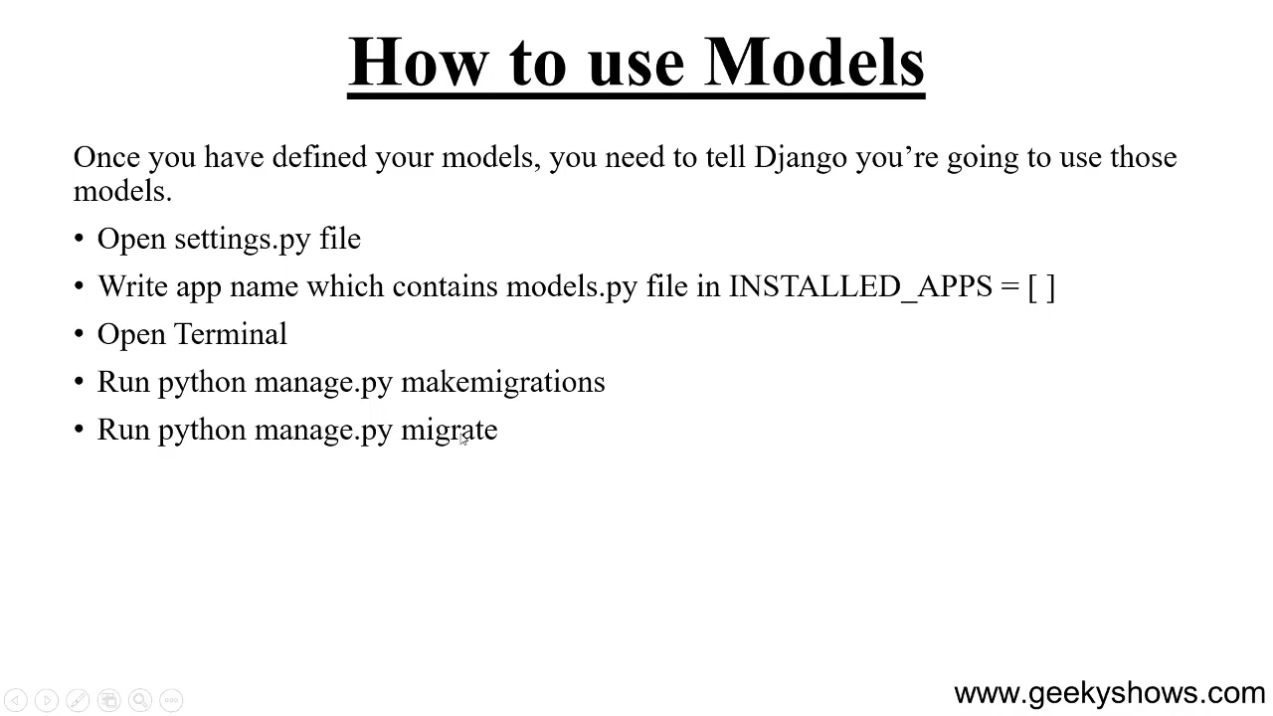

Slide 20
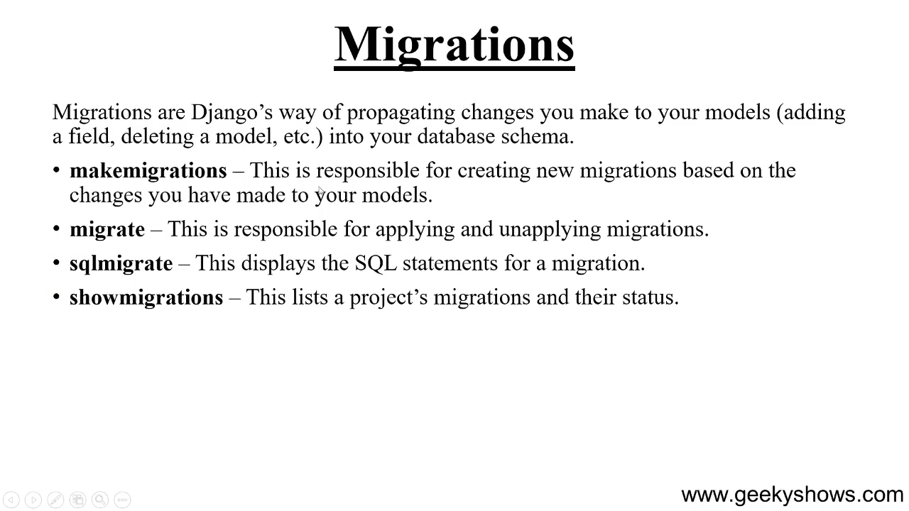

Slide 21
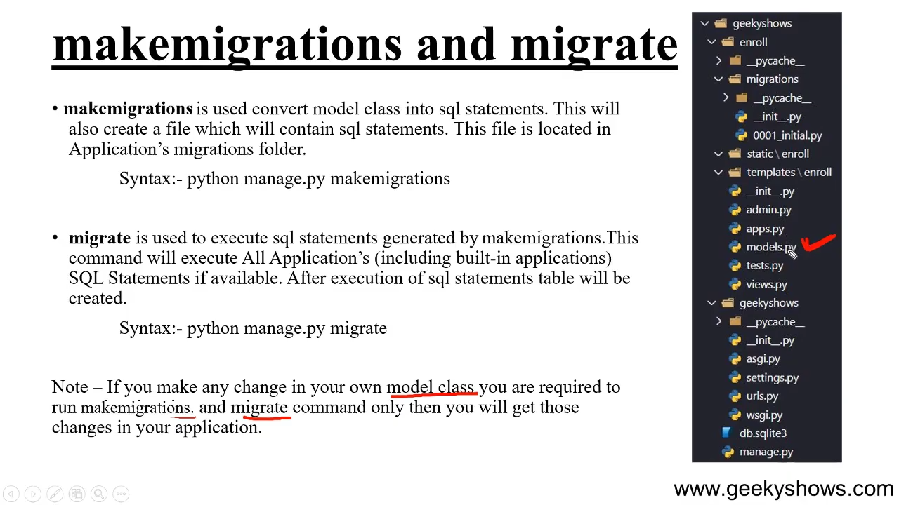

Slide 22
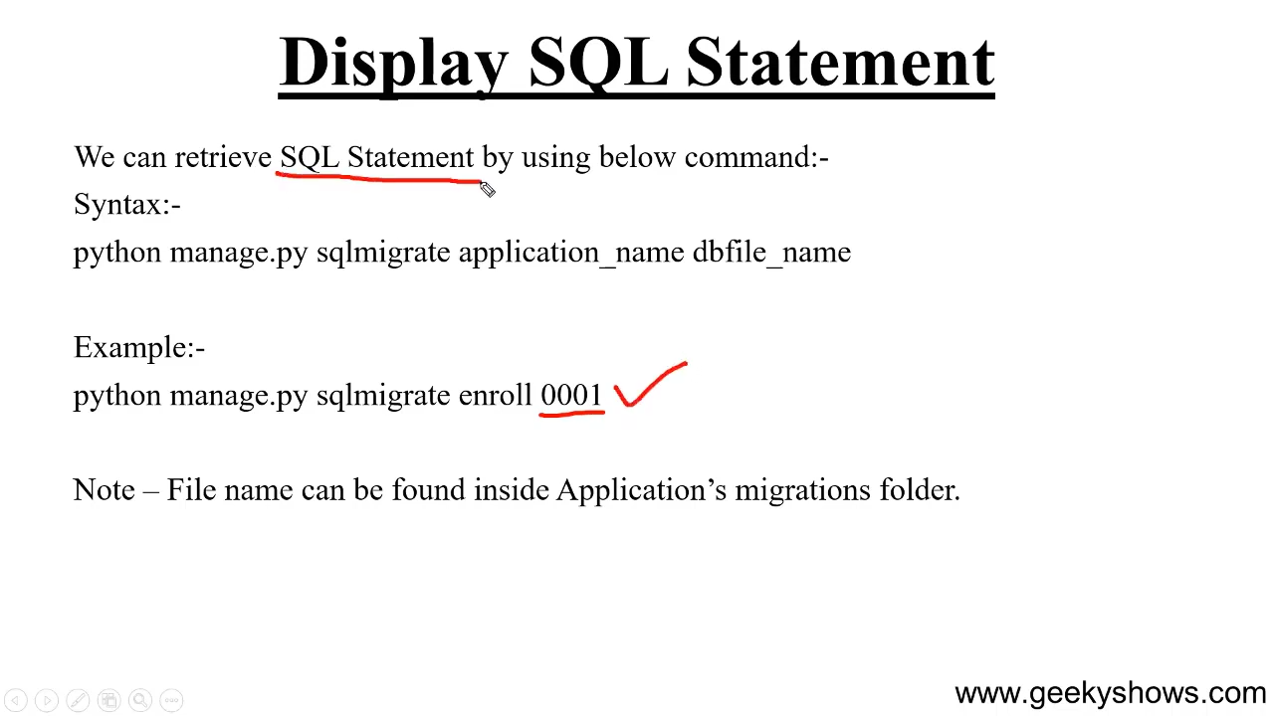

Slide 23
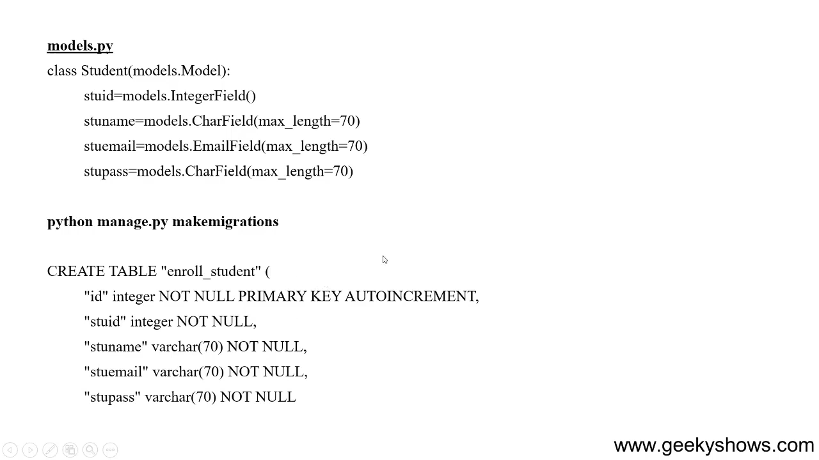

Slide 24
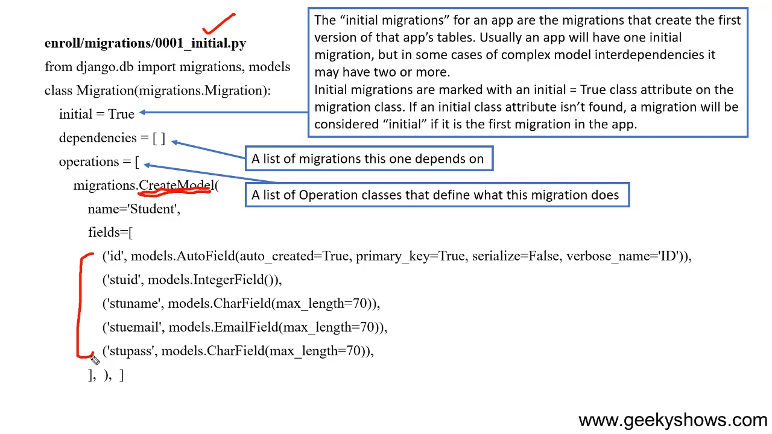

Slide 25
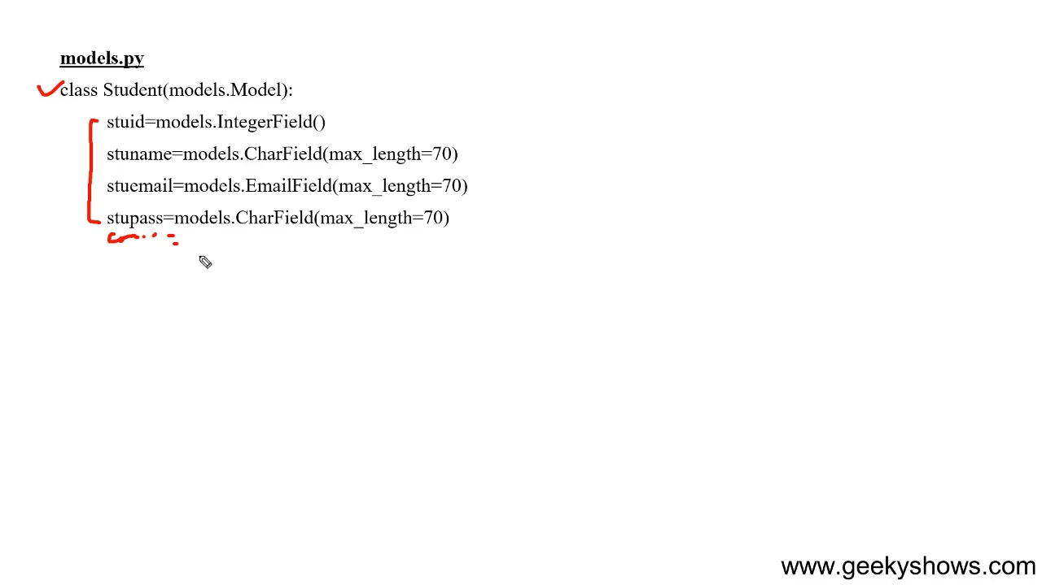

Slide 26
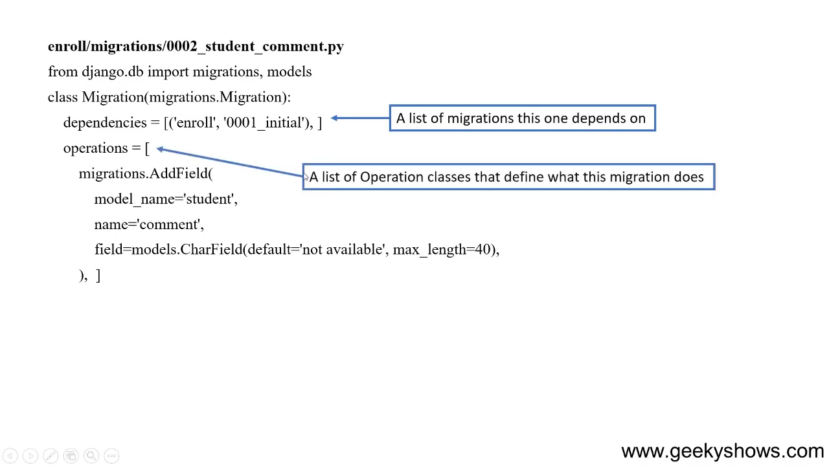

Slide 27
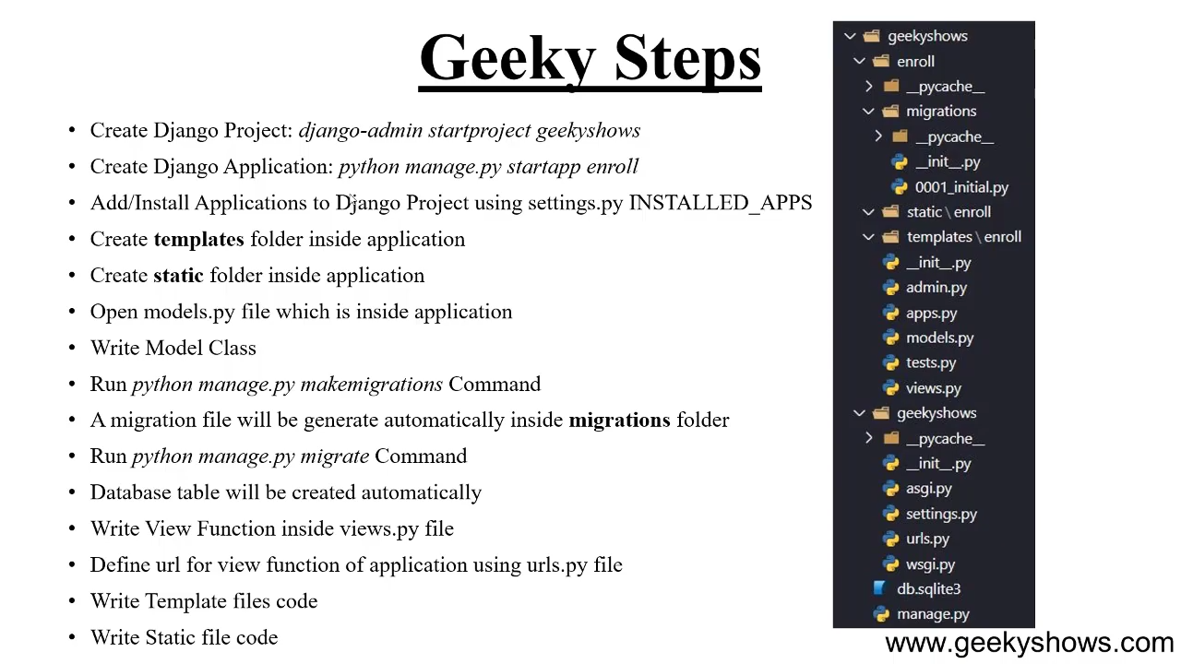

Slide 28
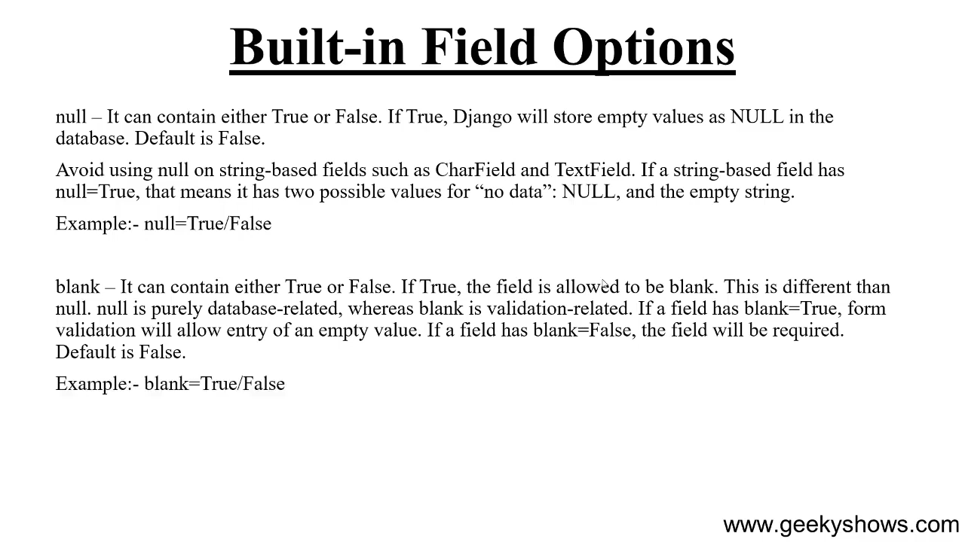

Slide 29
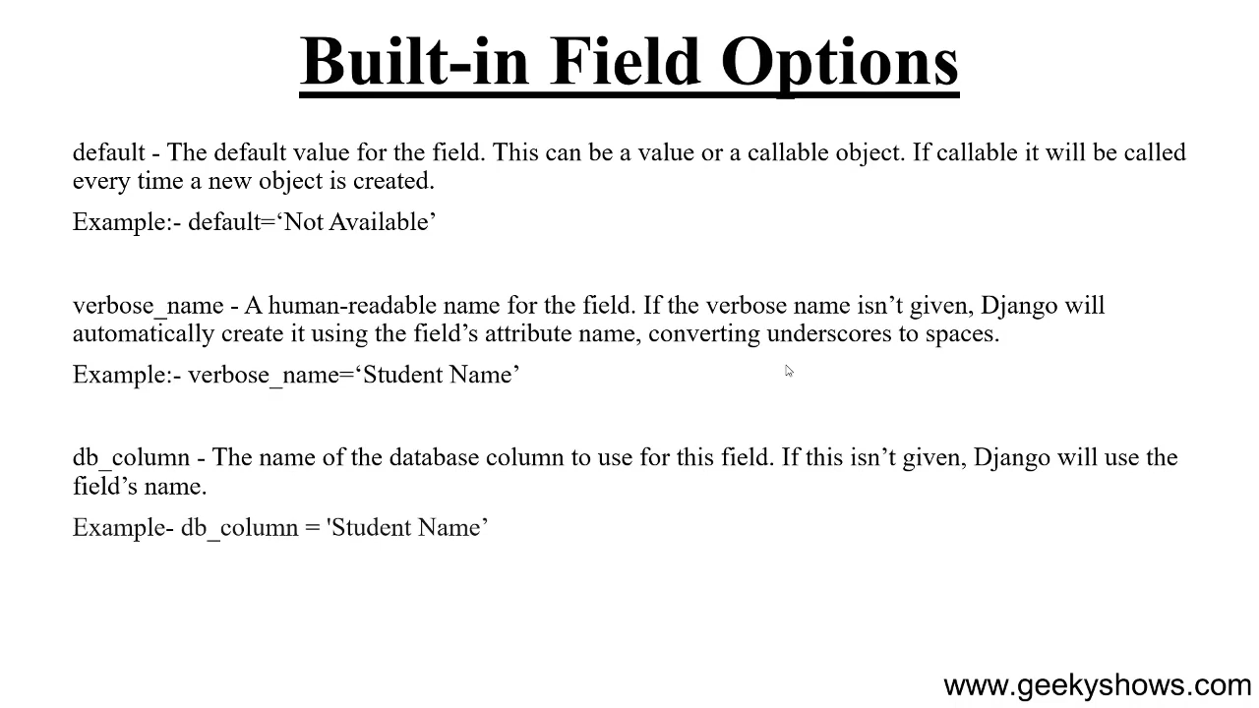

Slide 30
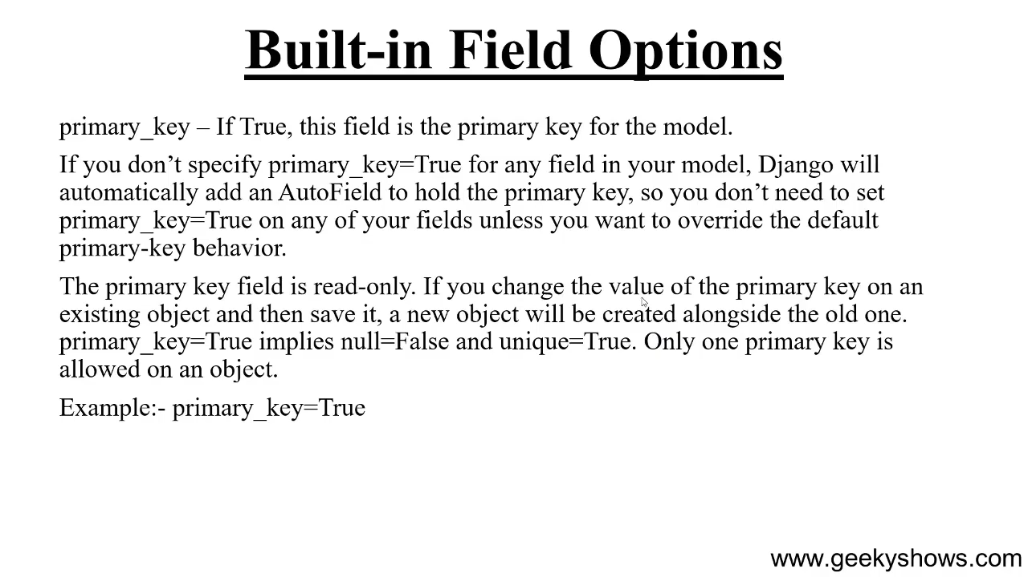

Slide 31
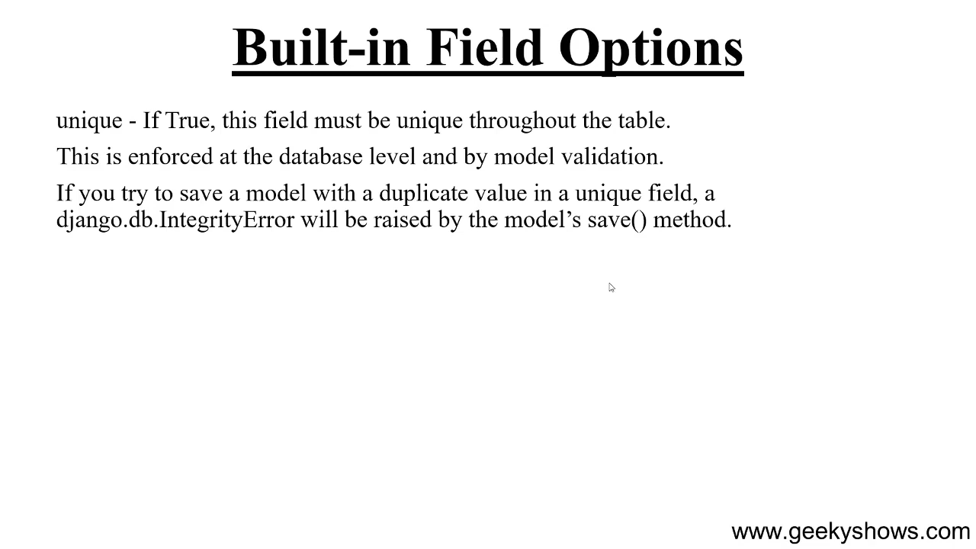

Slide 32
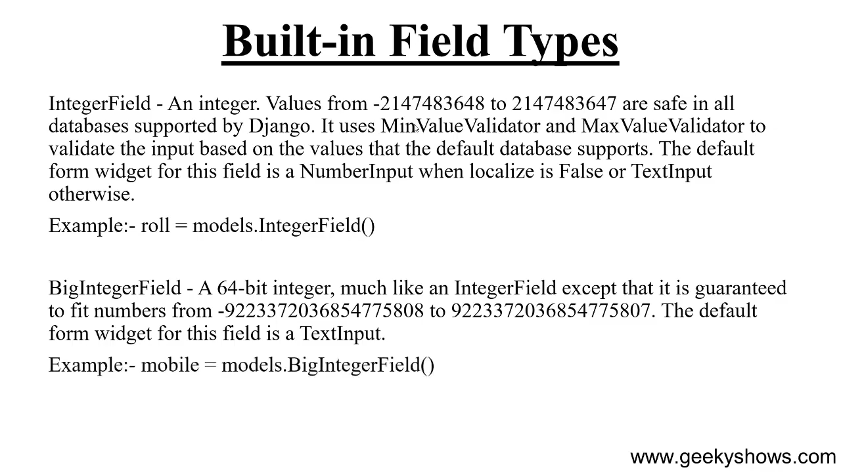

Slide 33
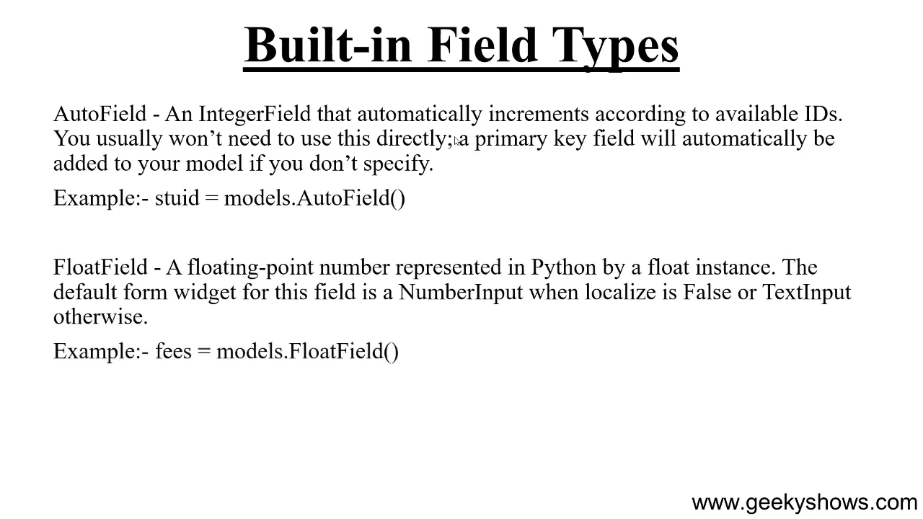

Slide 34
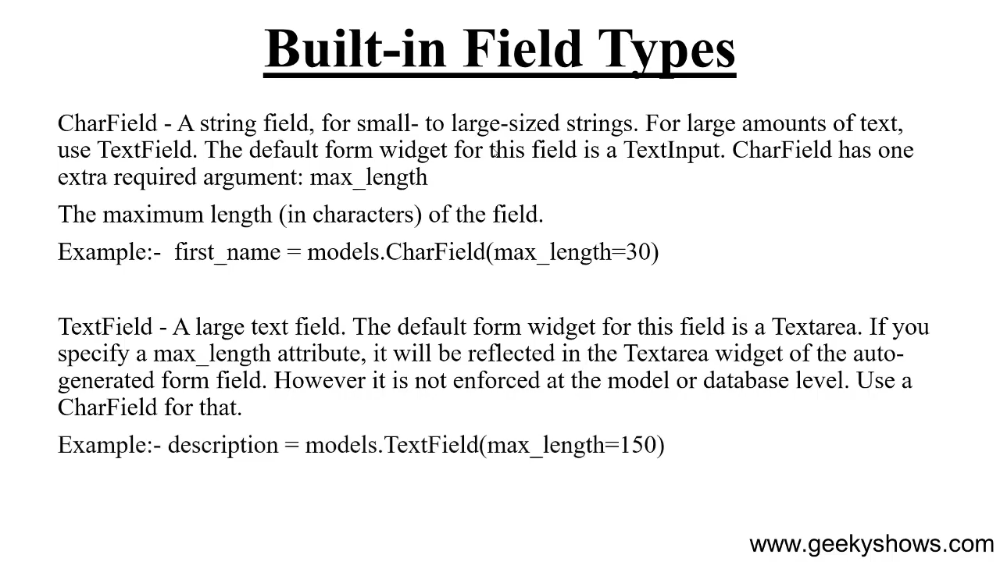

Slide 35
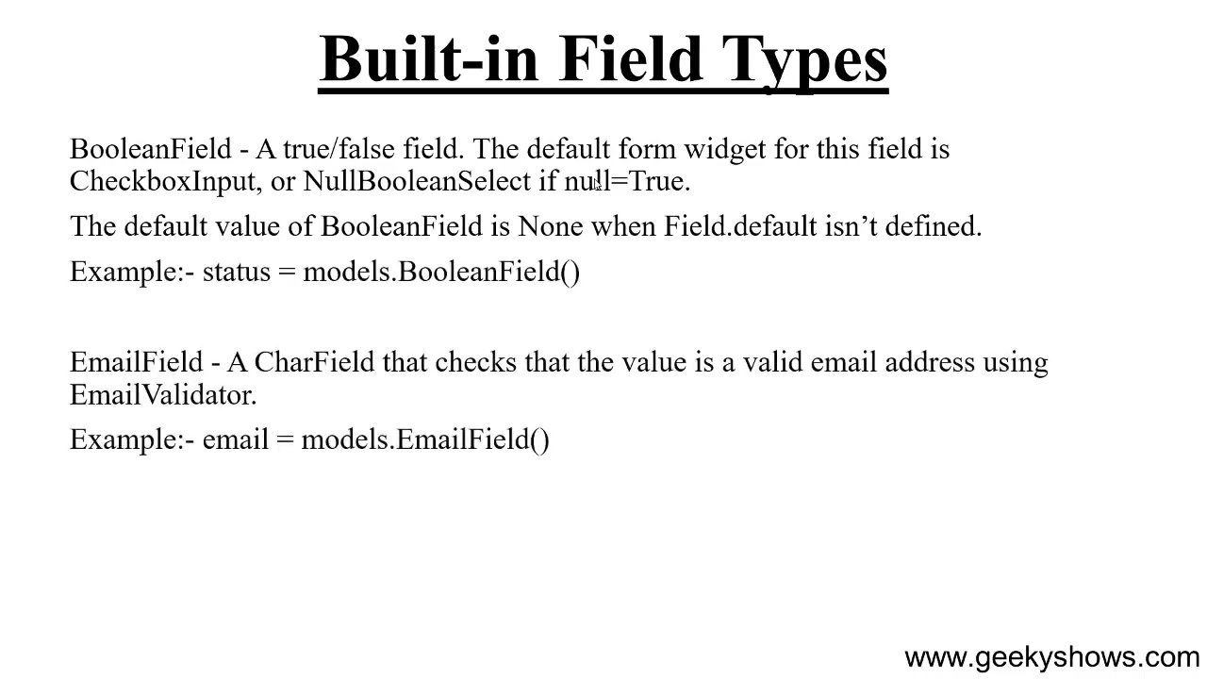

Slide 36
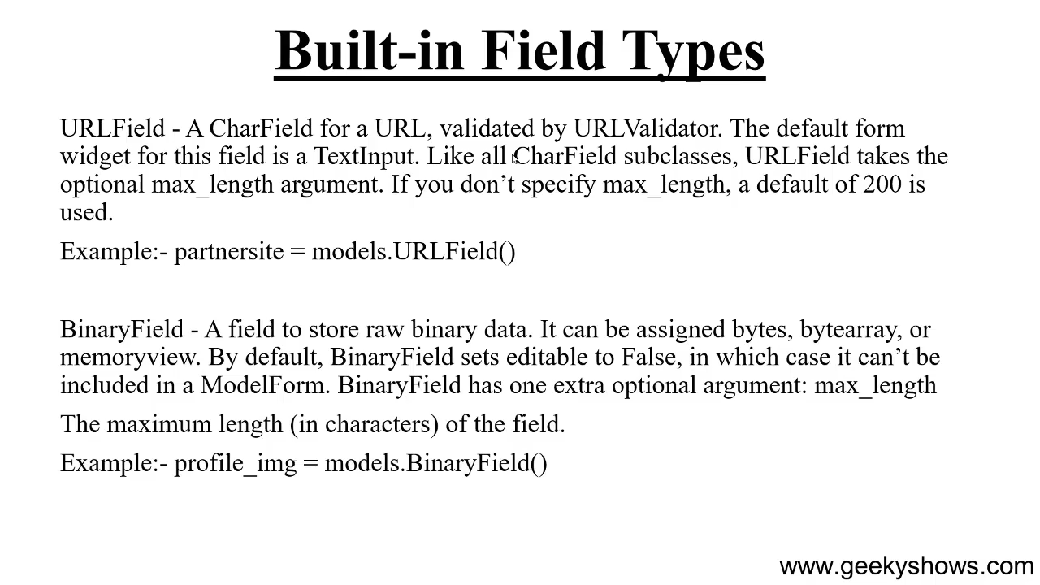

Slide 37
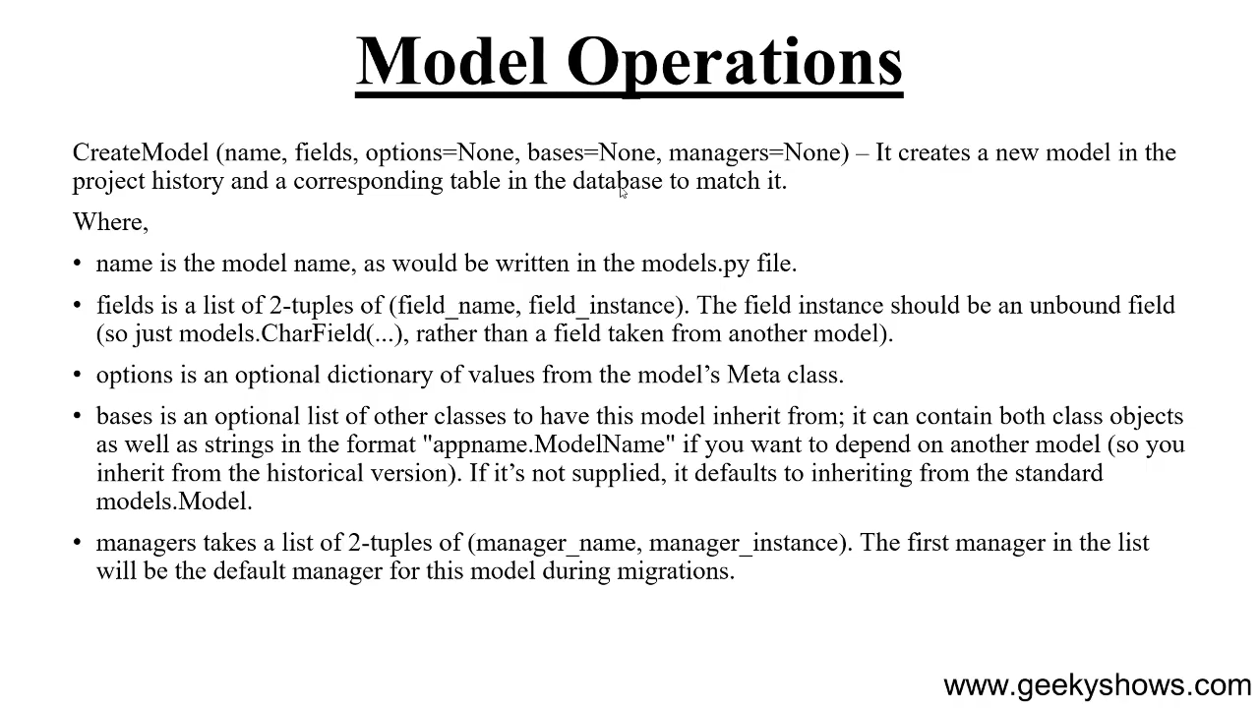

Slide 38
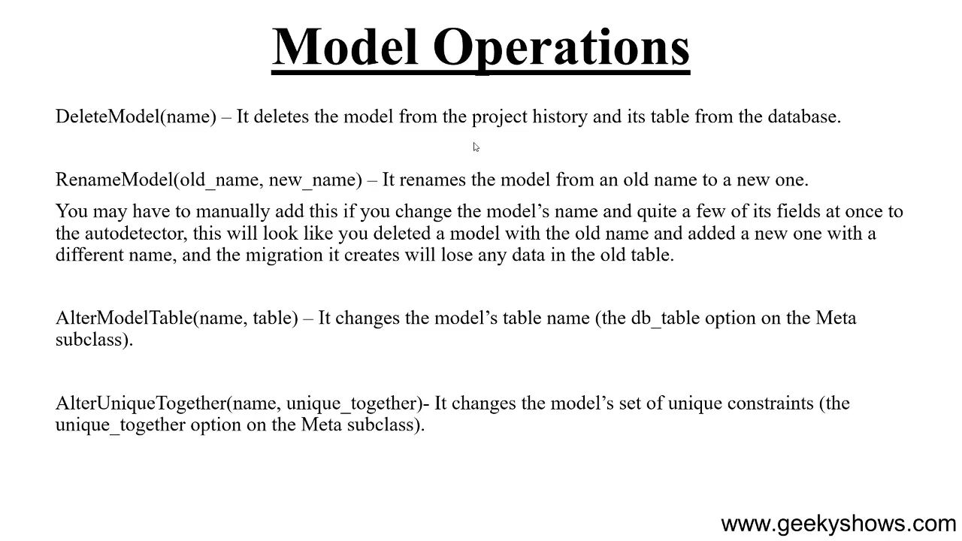

Slide 39
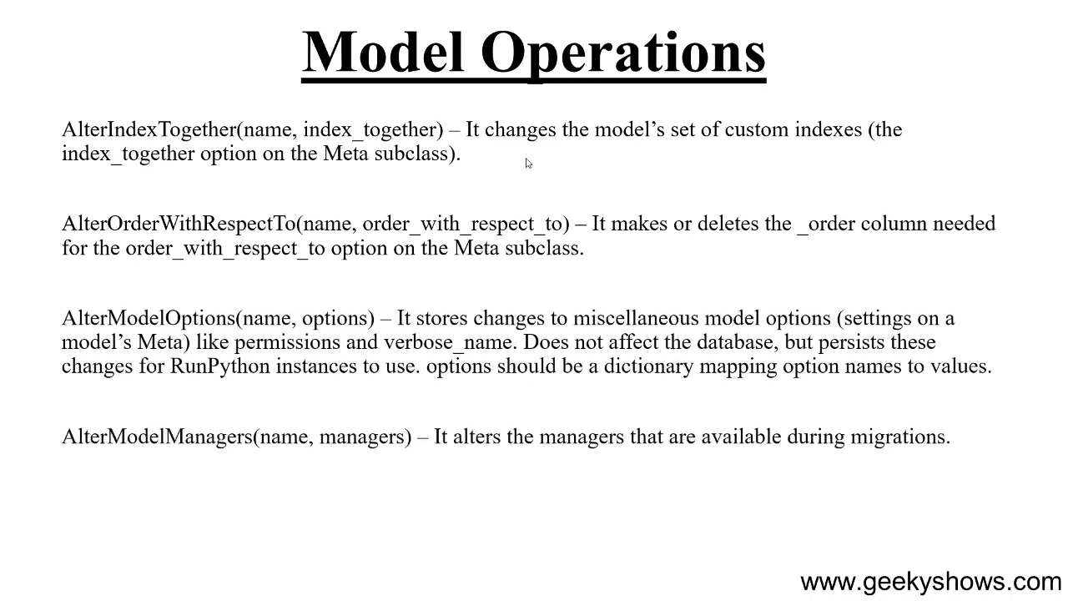

Slide 40
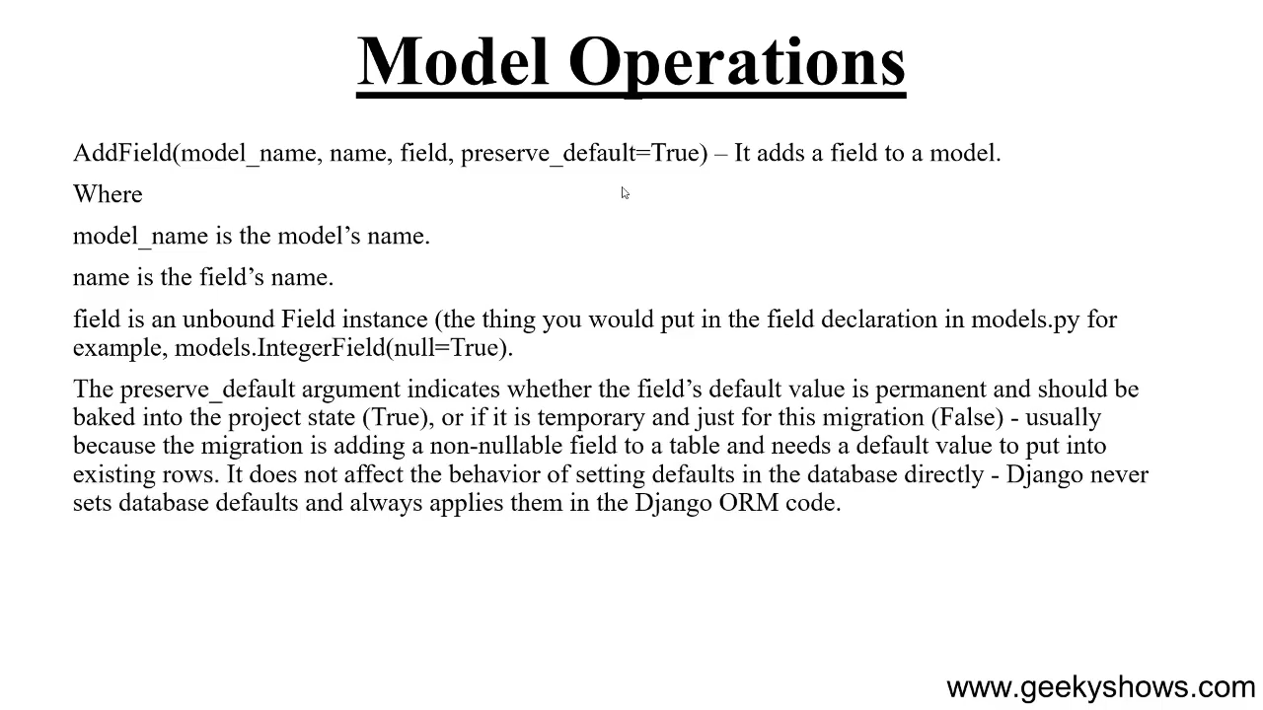

Slide 41
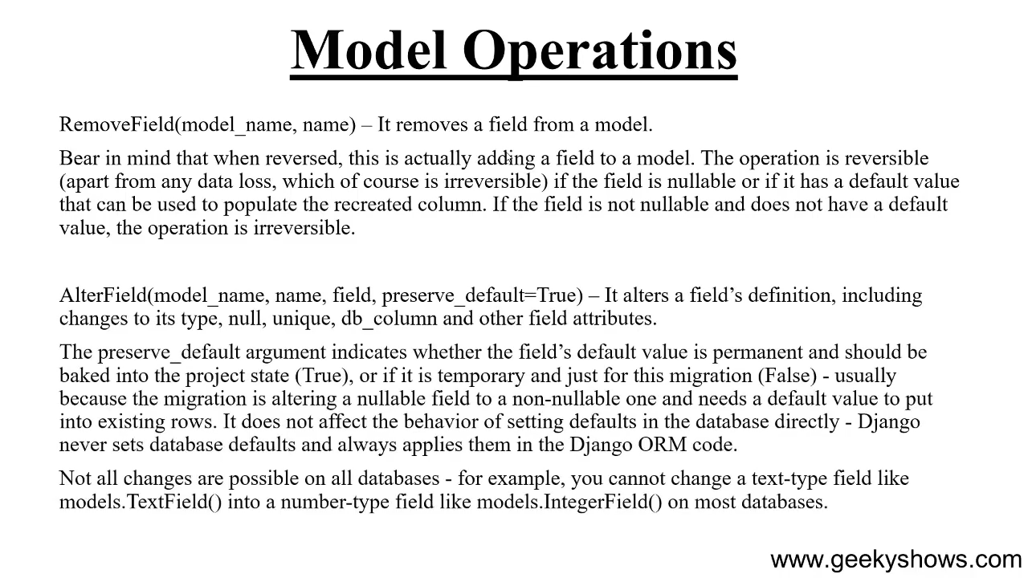

Slide 42
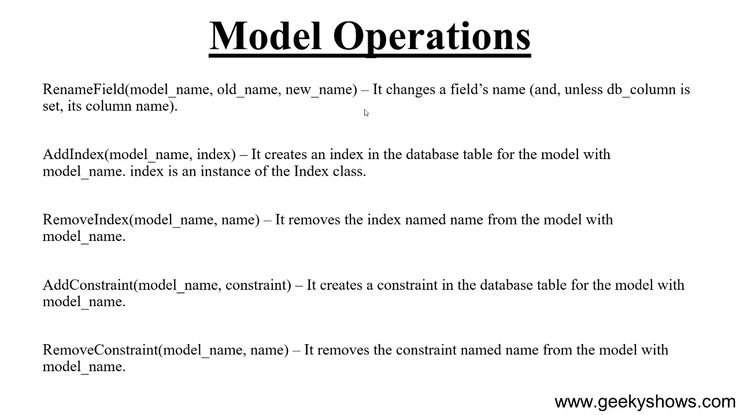

Slide 43
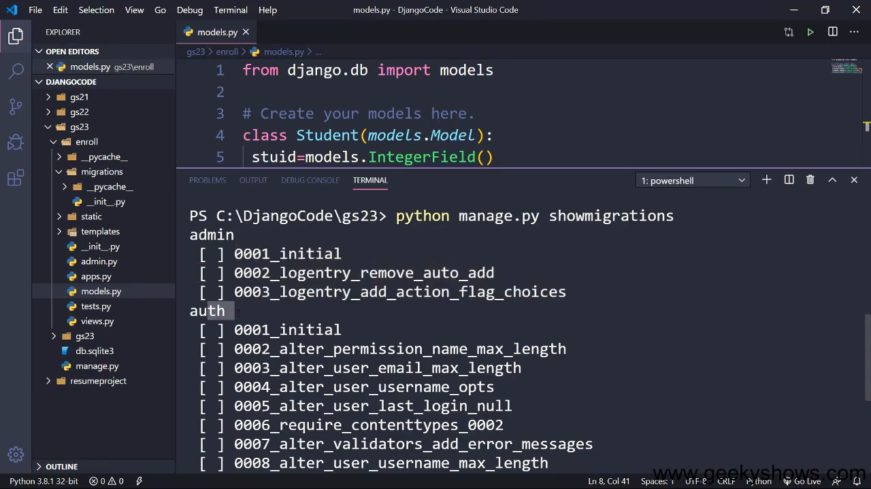

Slide 44
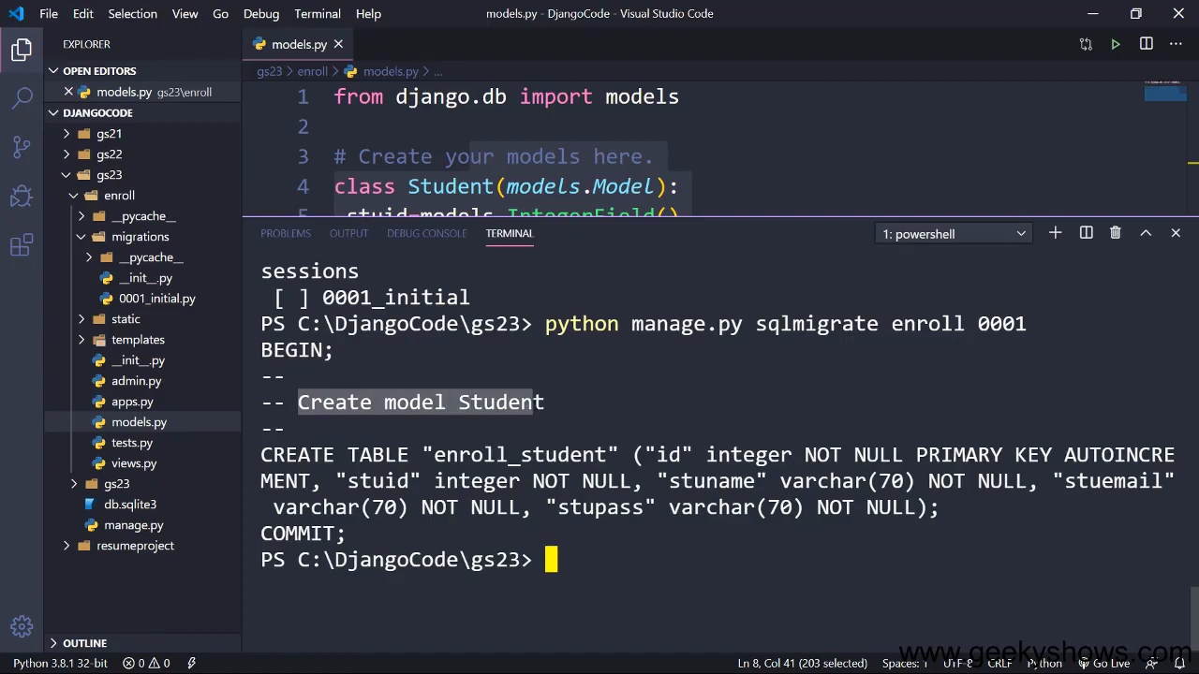

Slide 45
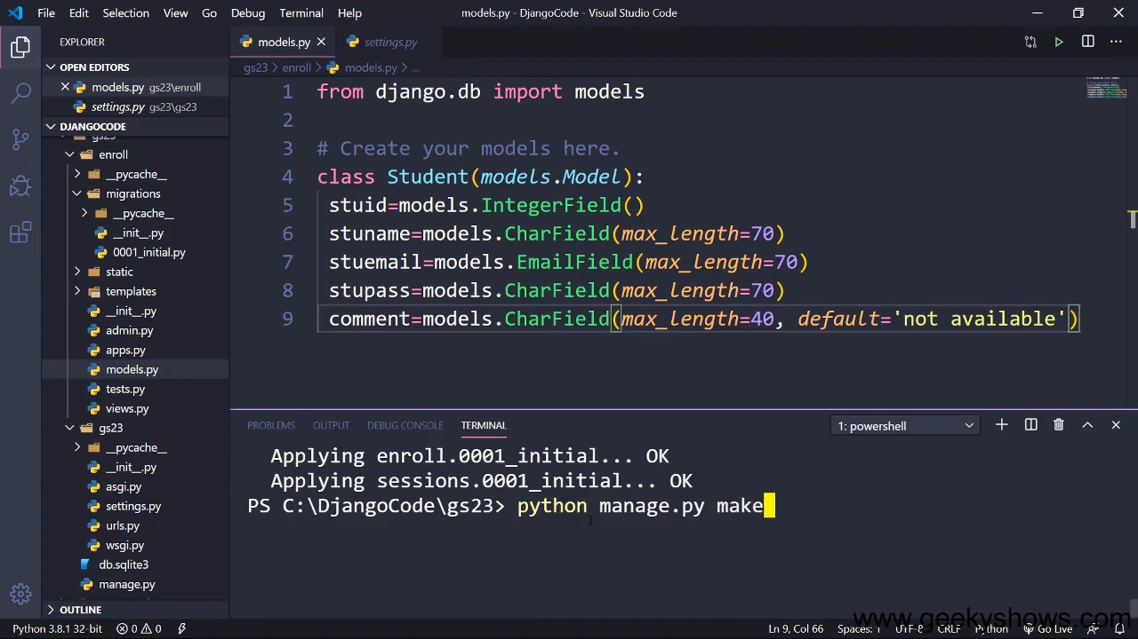

Slide 46
42. Show or Retrieve Database Table Data to User in Django

Slide 47
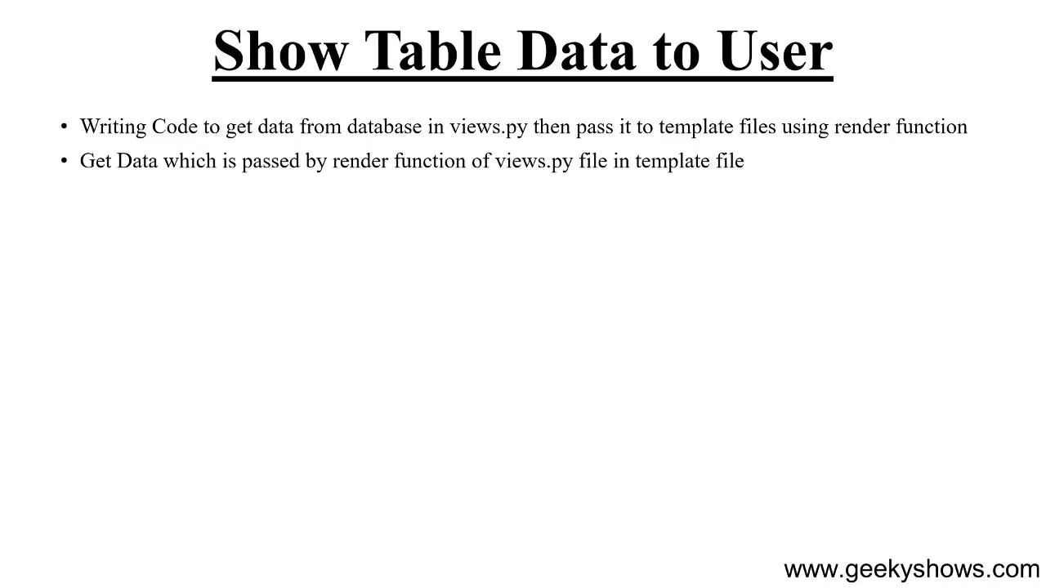

Slide 48
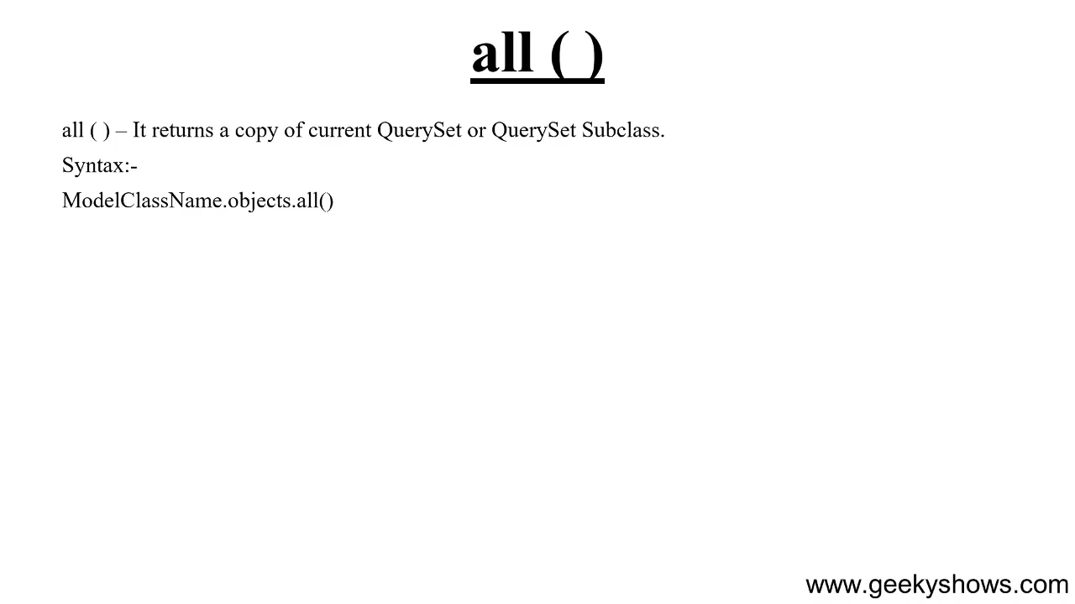

Slide 49
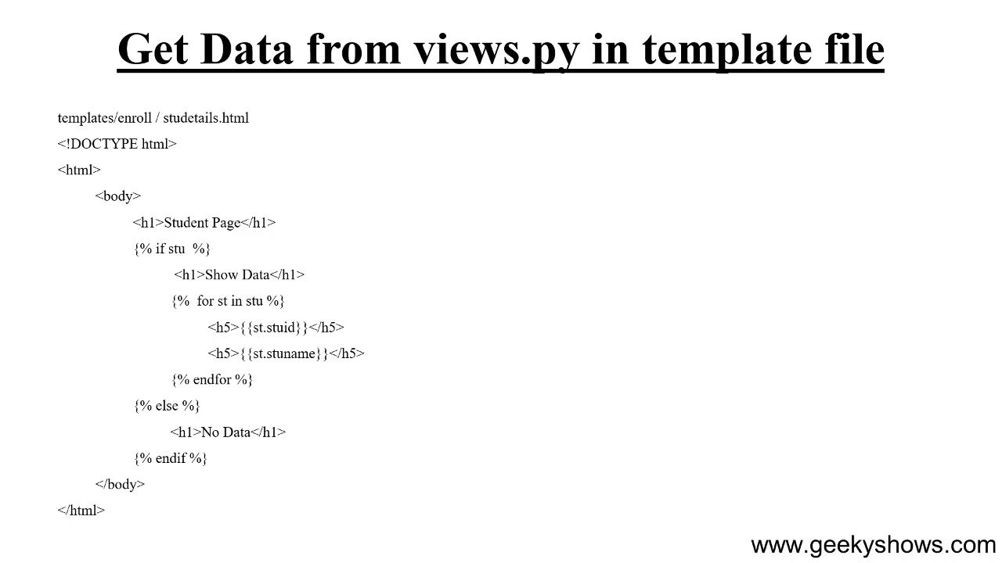

Slide 50
43. Admin Application and How to Create Super User in Django

Slide 51
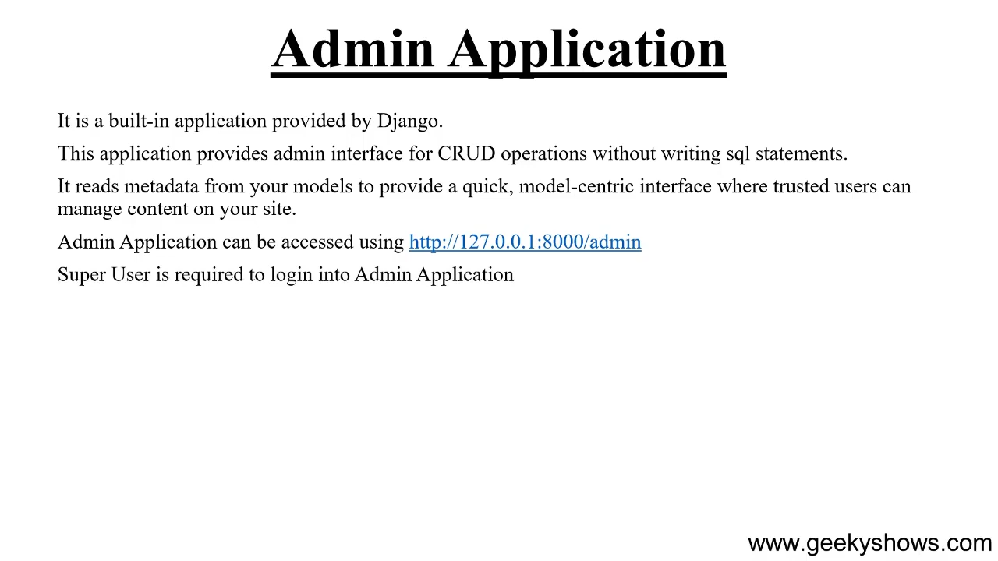

Slide 52
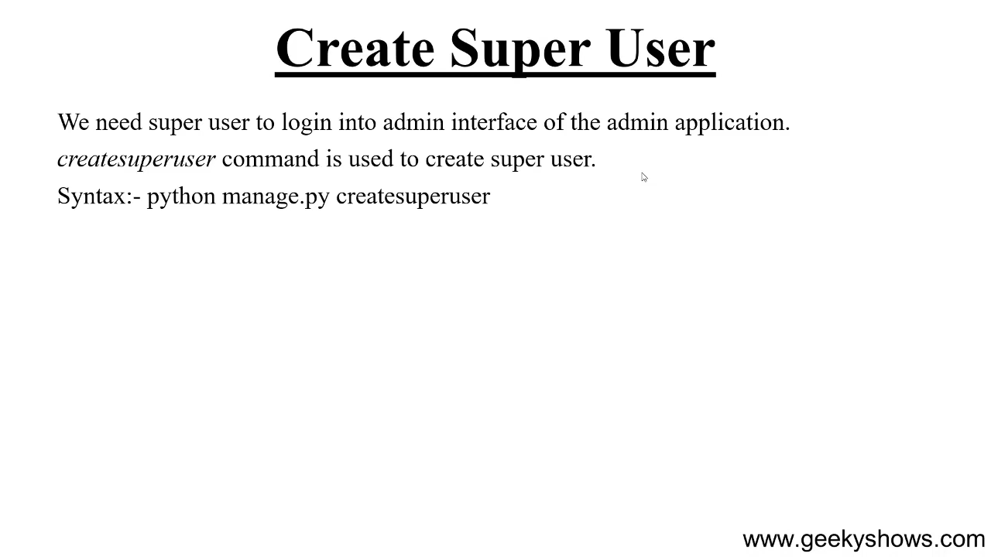

Slide 53
44. How to Register Model Class and use __str__ method in Django

Slide 54
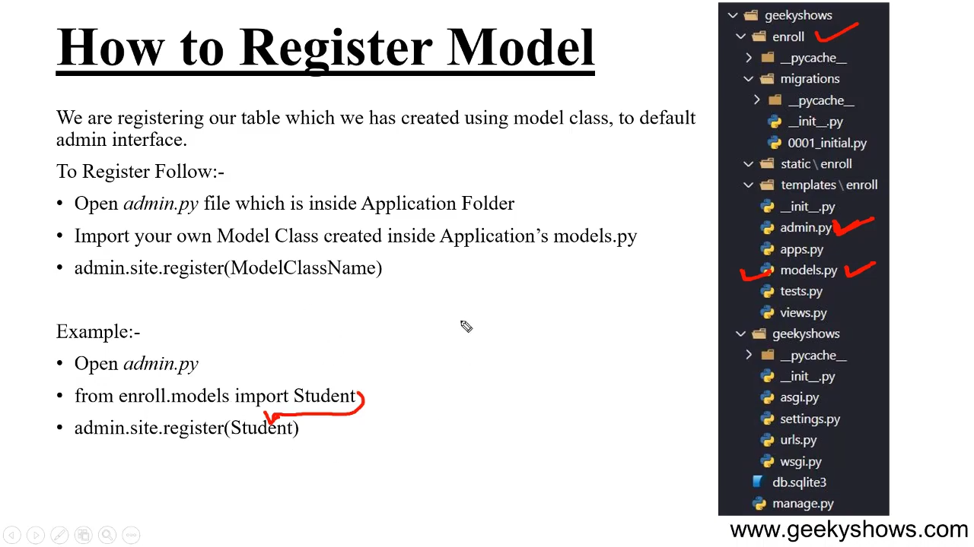

Slide 55
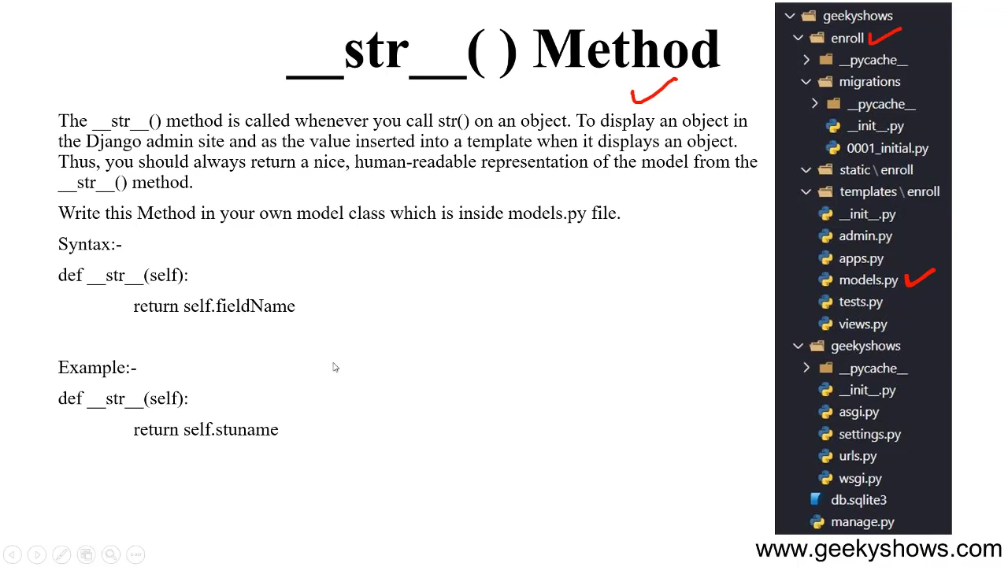

Slide 56
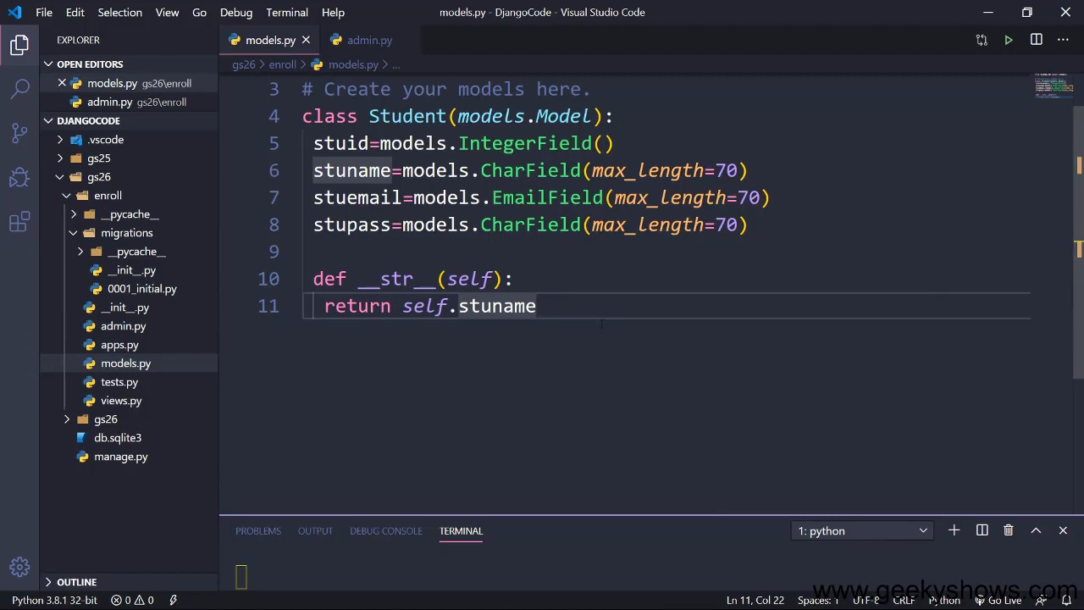

Slide 57


Slide 58
45. ModelAdmin Class and How to register ModelAdmin Class in Django

Slide 59
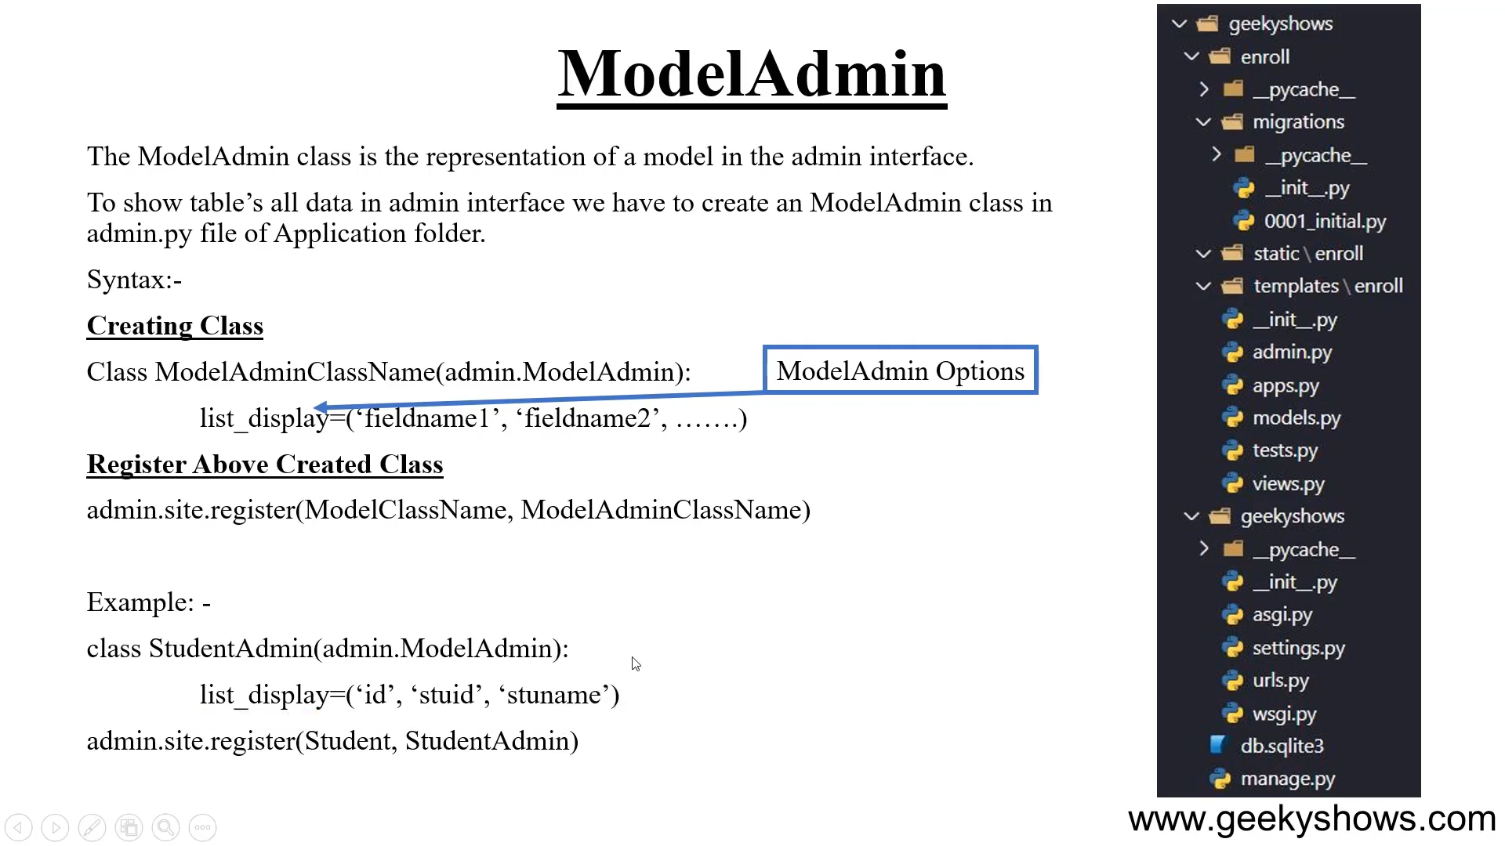

Slide 60


Slide 61


Slide 62


Slide 63


Slide 64


Slide 65
46. How to Create Django Form using Form API in Django

Slide 66


Slide 67


Slide 68


Slide 69


Slide 70


Slide 71


Slide 72


Slide 73


Slide 74


Slide 75


Slide 76


Slide 77


Slide 78


Slide 79
47. Configure id Attribute and label Tag and Dynamic initial Value in Django

Slide 80


Slide 81


Slide 82


Slide 83


Slide 84


Slide 85


Slide 86
48. Ordering Form Field in Django

Slide 87


Slide 88


Slide 89
49. Render Form Fields Manually in Django

Slide 90


Slide 91


Slide 92


Slide 93


Slide 94


Slide 95


Slide 96


Slide 97
50. Loop Form Fields and Form Hidden Fields in Django.

Slide 98


Slide 99


Slide 100


Slide 101


